Slide 1
Impact of Inbreeding in Holstein Dairy Cattle
Dr. John B. Cole
ISU Extension & Outreach Dairy Webinar | May 29, 2025

Slide 2
Topics for discussion
Inbreeding is different things to different people
New inbreeding matters more than old inbreeding
Inbreeding affects different traits in different ways
Nobody agrees what to do about it
Some thoughts on genetic defects
Conclusion

Slide 3
Inbreeding is different things to different people

Slide 4
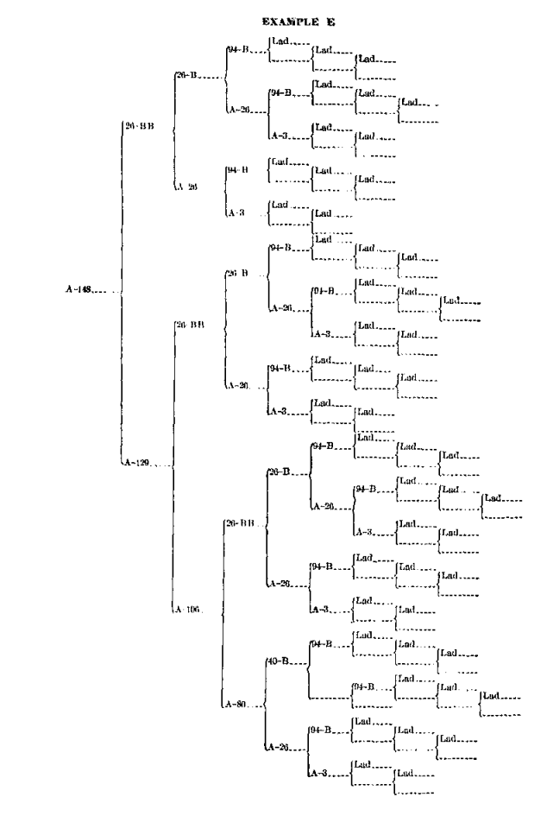
Inbreeding results from the mating of related animals
Cow A-148
f_{P} = 0.646
It’s the proportion of the genome that is identical because it came from the same ancestor
Inbreeding results when related animals are mated to one another
Inbreeding is inevitable in a finite population
It can be managed, but not avoided
Source: Swett et al. (1949)

Slide 5
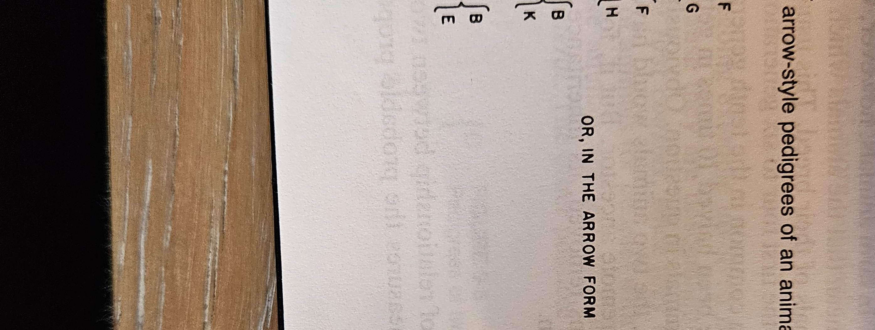
Pedigree inbreeding
Assumes each parent transmits ½ of their genome to their offspring, each grandparent ¼, etc.
Proportion of alleles identical by descent from a common ancestor
Legates and Warwick (1990)

Slide 6
Genomic inbreeding
It’s the proportion of homozygous alleles in an individual’s genome
It combines identity-by-descent with identity-in-state
Aerostar
Megastar
Aerostar
Chromosome 24

Slide 7
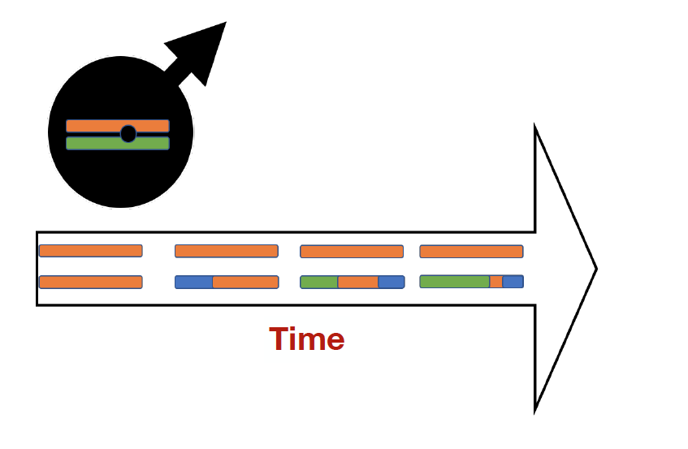
Runs of homozygosity (ROH)
Recent inbreeding produces long stretches of shared DNA
Old inbreeding is represented by shorter pieces of shared DNA
ROH provide information about specific places in the genome
Old stretches of inbreeding may be purged of harmful loci
Maltecca (2019)

Slide 8
Inbreeding often has undesirable effects
Harmful loci increase in frequency and are more likely to be paired-up
e.g., Haplotypes such as HH1
Probably accounts for most inbreeding depression
Slow inbreeding is more effective at selecting against harmful loci
Undesirable loci travel along with desirable loci if they’re close together (“hitchhiking”)

Slide 9
Why might selection favor inbreeding?
Multiple generations of intense directional selection (Robertson, 1961)
High variance of reproductive success across individuals due to the use of advanced reproductive technologies (Nicholas and Smith, 1983)
Use of BLUP-based genetic evaluations in combination with truncation selection (Verrier et al., 1993)
These result in widespread use of related individuals as parents of the next generation (e.g., Howard et al., 2017)

Slide 10
Sometimes, inbreeding is deliberate
Terminal crosses in livestock
This is very common in, e.g., poultry and swine breeding
Inbred lines in crop breeding
e.g., maize and wheat
Species in which fixation of phenotypic characteristics are more important than performance
Horses

Slide 11
New inbreeding matters more than old inbreeding

Slide 12
US Holstein cattle (proven genotyped bulls)
Source: CDCB (2024)

Slide 13
PINE-TREE ACURA-ET (029HO18960)
HOUSA000139005002 2007-09-17 COYNE-FARMS DORCY-ET 1 58k
HO840003006972816 2010-06-22 MOUNTFIELD SSI DCY MOGUL-ET 1 58k
HOUSA000062784081 2006-04-23 MOUNTFIELD MARSH MAXINE-ET 1 58k
HOUSA000072254526 2013-01-05 WOODCREST MOGUL YODER-ET 8 77k
HOUSA000060597003 2003-03-03 ENSENADA TABOO PLANET-ET 4 778k
HO840003008363689 2011-03-21 WOODCREST PLANET YAKARA-ET 3 3k
HOUSA000066893887 2009-05-18 COYNE-FARMS BKEYE YVONNE-ET 1 58k
HO840003128557482 2015-11-15 ABS ACHIEVER-ET 17 140k
HOUSA000060996956 2004-10-31 BADGER-BLUFF FANNY FREDDIE 1 58k
HONLD000543756297 2011-06-16 APINA ALTAEMBASSY-ET 2 58k
HOUSA000064969166 2008-12-01 STRAUSSDALE PLANET ELLA 1 58k
HO840003013177242 2013-09-30 COMPASS-TRT AMRC AE J925-ET 8 77k
HOUSA000064966739 2008-12-23 ROYLANE SOCRA ROBUST-ET 1 58k
HOUSA000070640281 2011-07-26 SEAGULL-BAY MISS AMERICA-ET 2 58k
HOUSA000066228178 2009-04-16 AMMON-PEACHEY SHAUNA-ET 1 58k
HO840003142332520 2017-11-25 PINE-TREE ACURA-ET 17 140k
HOUSA000069398748 2010-06-30 MOUNTFIELD MSY MAURICE-ET 2 58k
HO840003009554583 2012-05-22 S-S-I MAURICE PARTYROCK-ET 2 58k
HO840003006972817 2010-06-22 JK-GOLD SSI DORCYPIE7042-ET 1 58k
HO840003014334961 2014-01-01 S-S-I PARTYROCK PROFIT-ET 8 77k
HO840003006972816 2010-06-22 MOUNTFIELD SSI DCY MOGUL-ET 1 58k
HO840003009554577 2012-05-17 S-S-I MOGUL MAHO 8054-ET 7 9k
HO840003004672693 2010-08-26 S-S-I ROBUST MAHO 7083-ET 2 58k
HO840003132116871 2016-03-13 PINE-TREE 9882 PROF 7019-ET 20 19k
HOUSA000064966739 2008-12-23 ROYLANE SOCRA ROBUST-ET 1 58k
HOUSA000069981349 2010-12-28 SEAGULL-BAY SUPERSIRE-ET 2 58k
HOUSA000066228178 2009-04-16 AMMON-PEACHEY SHAUNA-ET 1 58k
HO840003011890130 2013-12-02 OCD SUPERSIRE 9882-ET 17 140k
HOUSA000064966739 2008-12-23 ROYLANE SOCRA ROBUST-ET 1 58k
HO840003008315320 2011-03-08 OCD ROBUST SHIMMER-ET 2 58k
HOUSA000066228180 2009-04-18 AMMON-PEACHEY SHANA-ET 1 58k
f_{P} | 12.8
f_{G} | 15.3
NM$ | 776
TPI | 3,096

Slide 14
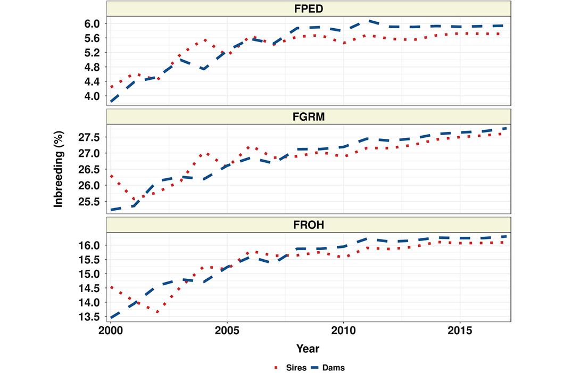
US Angus cattle
Source: Lozada-Soto et al. (2021)

Slide 15
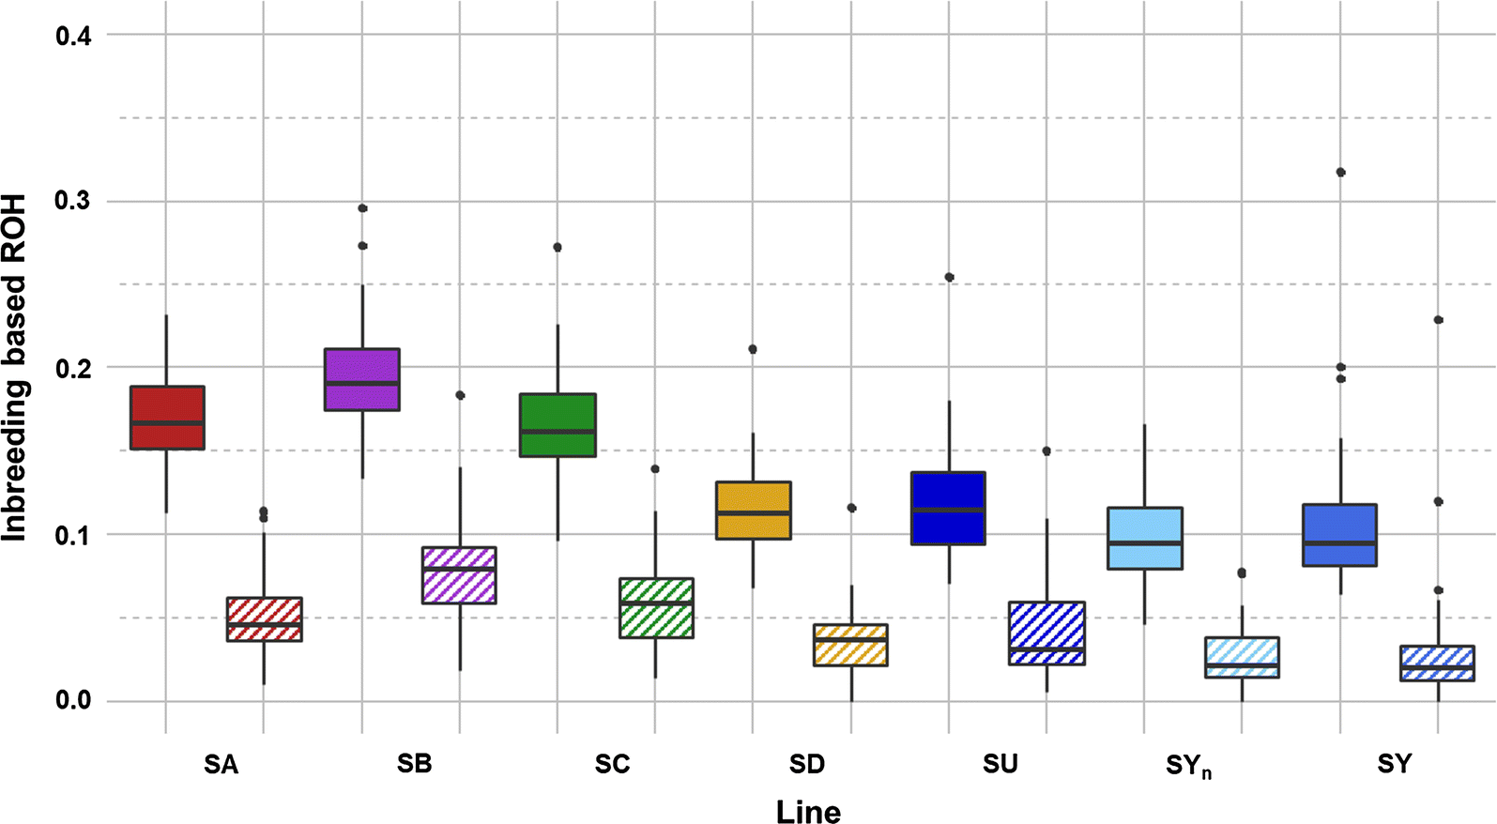
Commercial rainbow trout lines
Box plots of total inbreeding (FROH) and recent inbreeding (FROH>10) for each rainbow trout line.
Plain box: total inbreeding (FROH).
Hatched box: recent inbreeding (FROH>10).
Source: D’Ambrosio et al. (2019)

Slide 16
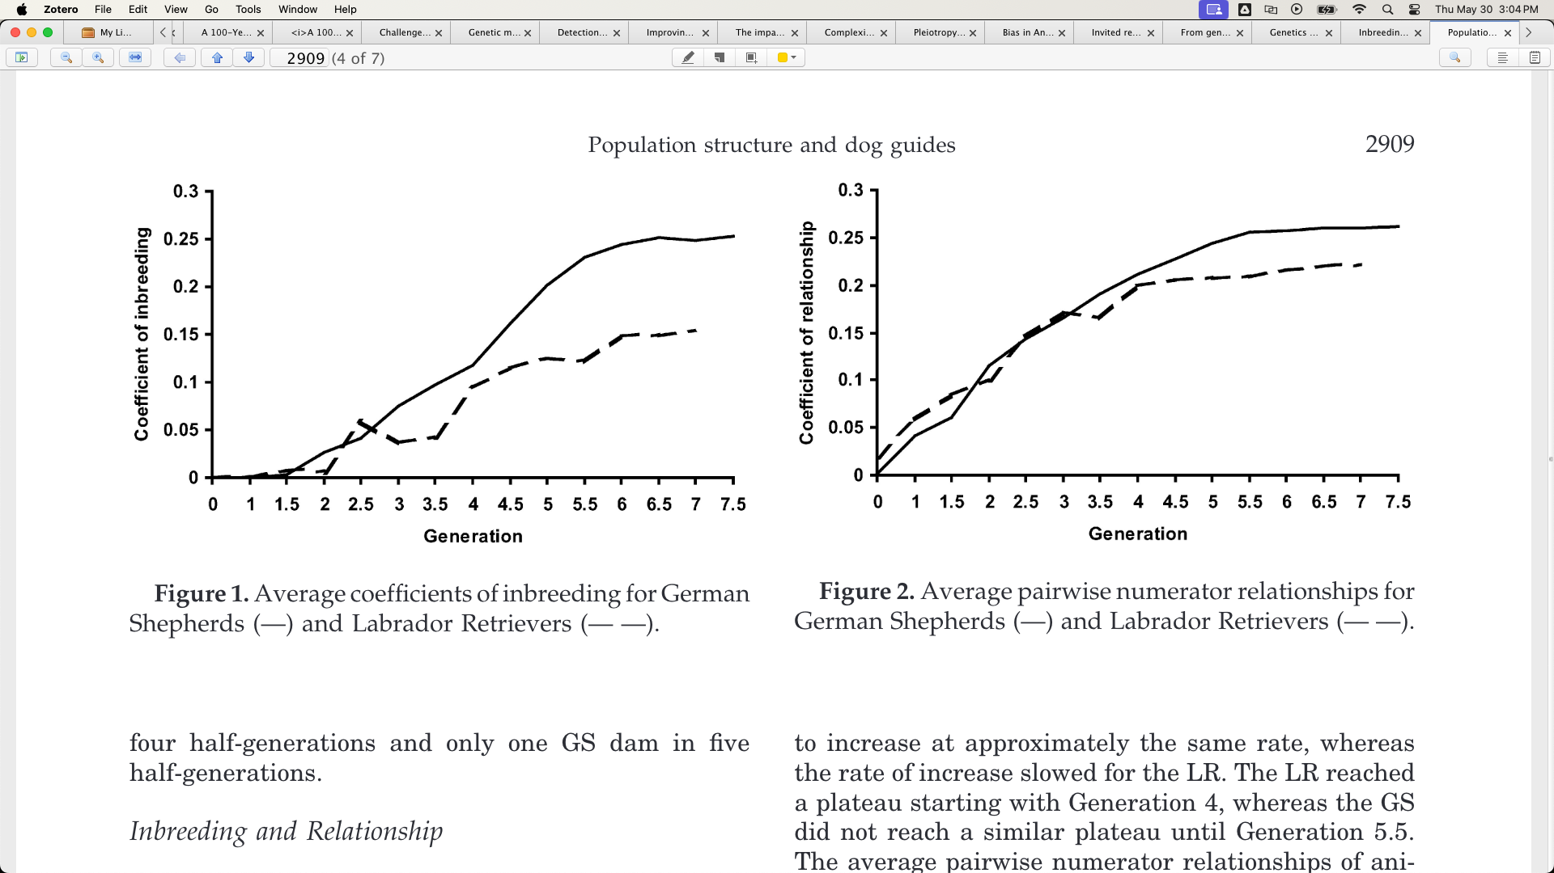
Working dogs
Source: Cole et al. (2004)

Slide 17
Inbreeding affects different traits in different ways

Slide 18
We don’t know how much is too much
Selection is now on indices that include health and fitness data
This avoids past mistakes from focusing on only one or a few traits
Will we see genetic merit gradually decrease, or will we cross a threshold and see a sudden crash?
Interviewer: “How did you go bankrupt?” Ernest Hemingway: “Two ways. Gradually, then suddenly.”
Correlation: -0.23.
Source: CDCB (2019).

Slide 19

Inbreeding can harm performance
b_{m} = -0.191
b_{m} = -0.489
b_{m} = -0.29
b_{m} = -0.367
Fertility
Adult Survival
Body Weight
Milk Yield
Inbreeding
Inbreeding
Inbreeding
Inbreeding
b_{m} = -0.249
b_{m} = -0.225
b_{m} = -0.414
b_{m} = -0.215
Fat Yield
Protein Yierld
SCC
Locomotion
Inbreeding
Inbreeding
Inbreeding
Inbreeding
Leroy (2014)

Slide 20
Should dairy farmers worry about inbreeding?
Change in phenotypic performance per 1% (0.25%) increase in inbreeding
Milk | Fat | Protein | PL | SCS | DPR | HCR | CCR | LIV
-73.6 | -2.70 | -2.10 | -0.28 | 0.01 | -0.22 | -0.22 | -0.31 | -0.11
-18.4 | -0.67 | -0.52 | -0.07 | 0.0025 | -0.05 | -0.05 | -0.08 | -0.03
Source: CDCB (https://webconnect.uscdcb.com/#/summary-stats/breed-means-bases-heterosis-inbreeding-regressions).
Change in genetic potential per year when selecting on NM$
Milk | Fat | Protein | PL | SCS | DPR | HCR | CCR | LIV
+126.9 | +7.7 | +4.4 | +0.49 | -0.02 | +0.03 | +0.15 | +0.15 | +0.25
Source: AGIL, ARS, USDA (https://www.ars.usda.gov/ARSUserFiles/80420530/Publications/ARR/nmcalc-2021_ARR-NM8.pdf).

Slide 21
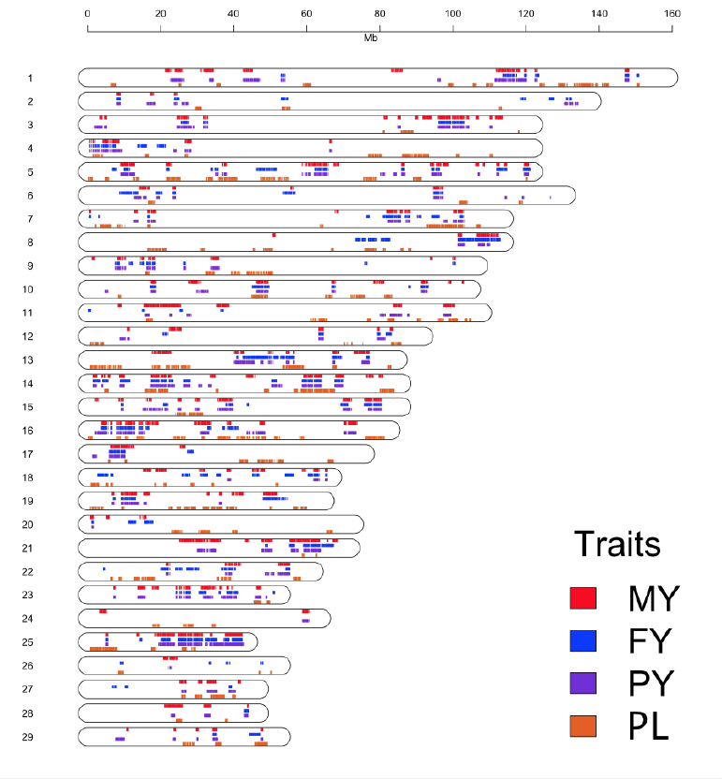
ROH used to find undesirable, but not lethal, regions
Some mutations in the population are sub-lethal: they harm performance but don’t kill animals
They are more difficult to find than lethal haplotypes
May appear in ROH
Maltecca (2019)

Slide 22
Nobody agrees on what to do about it

Slide 23
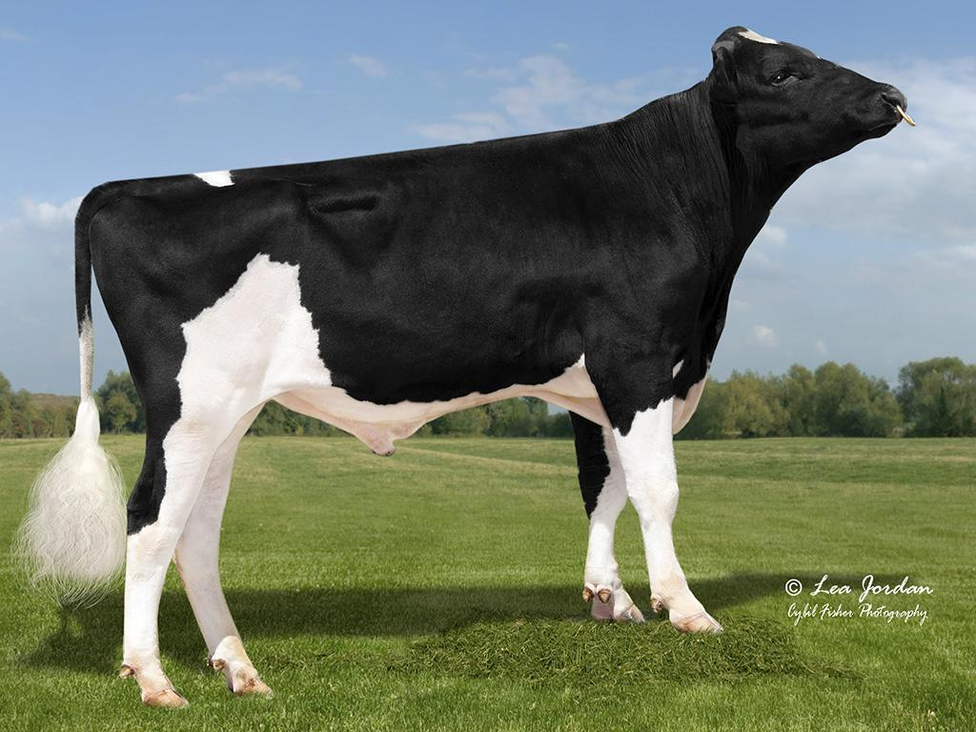
We can adjust PTAs to account for inbreeding
Penalize bulls whose daughters are more related to the breed?
Use genomic rather than pedigree inbreeding?
The US does both!
Limit active bulls from the same sire family?
What about embryo donors?
Source: Alta Genetics

Slide 24
We can trim pedigrees?
Inbreeding melts away with the touch of a button!
Reflects the biological impact of new versus old inbreeding
Some countries already do this
Italy (4), Slovak Republic (3), UK (5)
Some countries have more recent “founder” years

Slide 25

What if we don’t publish PTAs?
To avoid overuse of bulls, no PTA will be published
Bulls will be mated at random to cows
Or, bulls can receive “red”, “yellow”, or “green” badges to indicate trait quality
Or, only the mate selection software knows the PTA

Slide 26
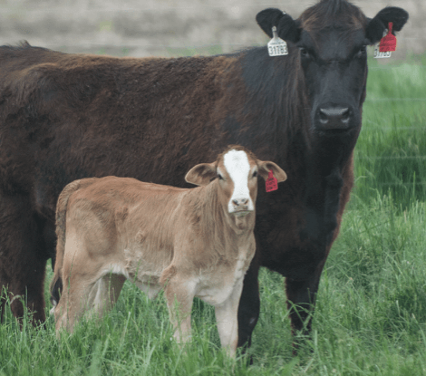
We could use terminal dairy embryos?
Instead of selling semen, we could sell embryos which represent the ideal terminal dairy cross
There would be no inbreeding!
Who will maintain the needed purebred lines?
Is the cost of creating and transferring these embryos manageable?

Slide 27
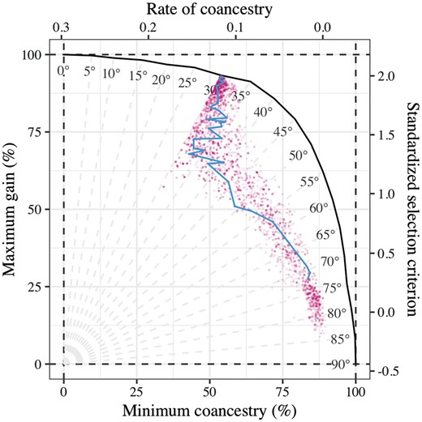
We can change the index
Add some measure of genetic diversity to selection indices
A possible opportunity to use subpopulation membership
Isn’t this just a less-efficient way of implementing optimal contribution theory, which we’ve all been carefully ignoring?

Slide 28
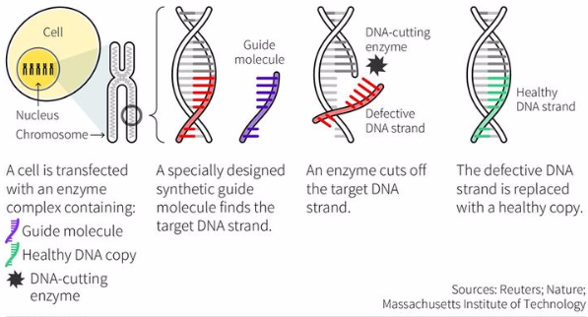
Could gene editing be the solution?
What if we just use gene editing to “fix” defects when we find them (Johnsson et al., 2019)?
You only lose a few months with surrogate sires!
We can get rapid genetic gain without consequences!
Do we know where it’s important to have diversity?

Slide 29
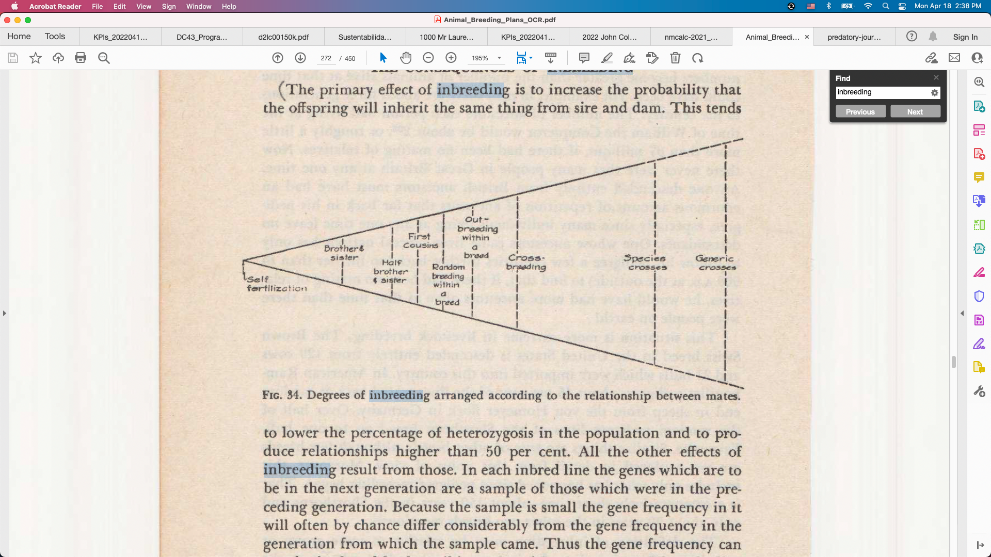
We can outcross between studs
AIs are creating sub-populations within breeds because of genetic protection programs
Will this lead to rotational breeding from each stud in turn?
How much difference should we expect if we’re all using similar breeding objectives?
Source: Lush (1945)

Slide 30
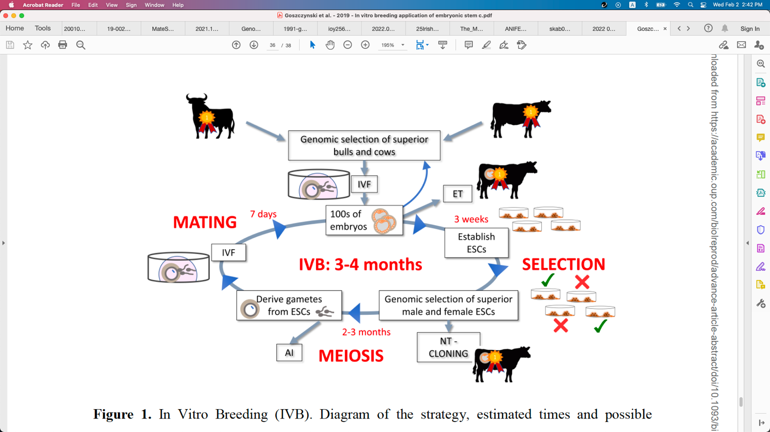
Will in vitro breeding ever work?
Embryonic stem cells can be turned into sperm and eggs and used to create a new generation of embryos (Goszczynski et al., 2018)
Faster genetic gain because less time is needed to create the next generation
Live animals eventually needed

Slide 31
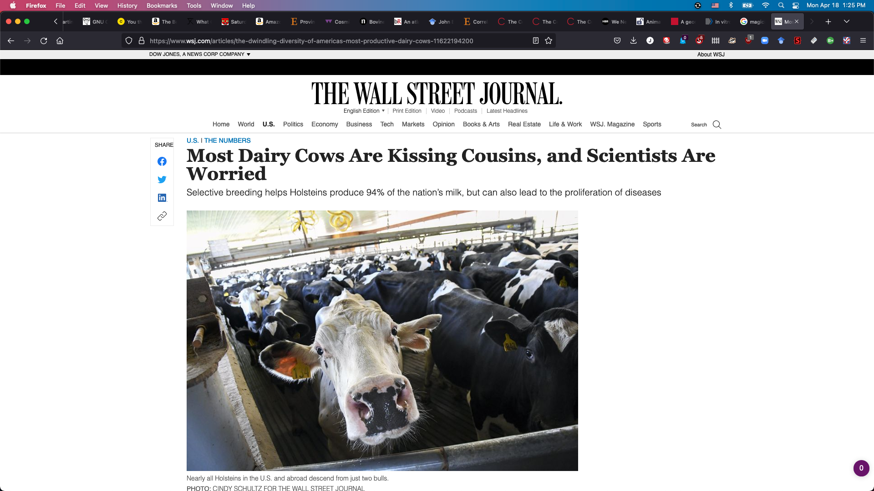
Will we retain license to operate?
Inbreeding may impact our social license more than production economics
People don’t understand the selection on performance practiced by livestock farmers
What will consumers, retailers, and bankers demand?

Slide 32
Am I serious about this?
Genetic evaluation is a tool for ranking animals for selection, not managing genetic diversity
We can favor “outcross” animals, if we can find them, and penalize “inbred” animals
Such adjustments lack theoretical justification and can’t achieve what we want them to
Would we rather pretend we’re doing things, or make changes that have real impacts (Cole, 2024)?

Slide 33
Do other solutions to the problem exist?
There are many theoretically satisfying ideas nobody uses
Geneticists and AI staff don’t breed cows, farmers do
Many cows are now mated at random to groups of bulls
Everyone’s neighbor should use different bulls
Some ways to avoid inbreeding
Optimal contribution theory
Minimization of progeny inbreeding
Linear programming
Look-ahead mate selection
Selection against lethal alleles
Index selection including Mendelian sampling variance
Genomic selection including dominance

Slide 34
Some thoughts on genetic defects

Slide 35
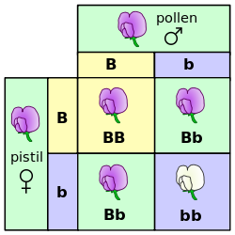
Mendelian recessives are exposed by inbreeding
Classical model of inheritance
One locus, typically with two alleles
Often exhibit complete dominance
e.g., Mendel’s experiments
Source: Wikimedia.

Slide 36
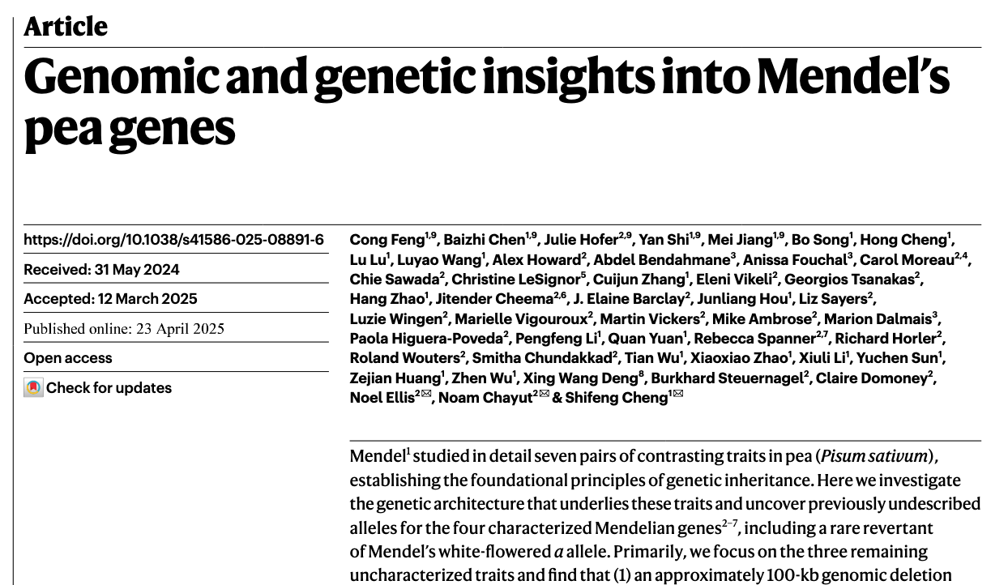
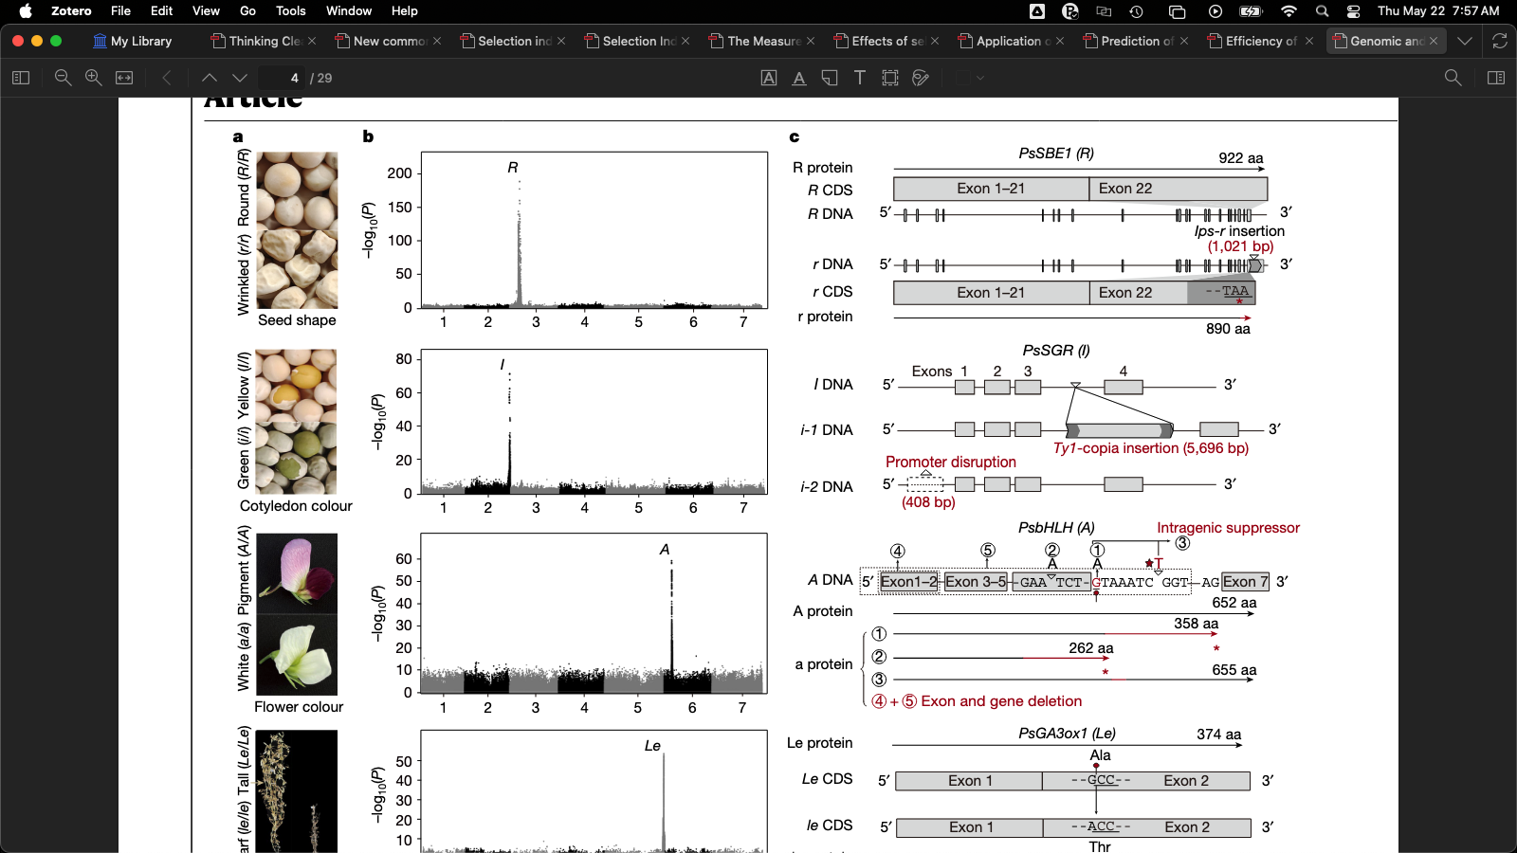
Breaking news about Mendel’s peas!
Wasn’t this all worked out in 1865 (Natural History Society of Brno, 1865; Verhandlungen des naturforschenden Vereines in Brünn, 1866)? Not exactly…

Slide 37
Known genetic defects in US Holsteins
Haplo- Type | Functional/Gene name | BTA chromosome | Location (Mbp) | Haplotype frequency (%) | Timing¹
HCD | Cholesterol deficiency/APOB | 11 | 78.0 | 0.34 | W
HH0 | Brachyspina/FANCI | 21 | 21.2 | 0.28 | E,B
HH1 | APAF1 | 5 | 63.2 | 0.40 | E
HH2 | IFT80 | 1 | 107.1 | 0.68 | E
HH3 | SMC2 | 8 | 95.4 | 0.65 | E
HH4 | GART | 1 | 1.3 | 0.09 | E
HH5 | TFB1M | 9 | 91.28– 91.9 | 2.50 | E
HH6 | SDE2 | 16 | 29.0 | 1.14 | W
HHB | BLAD/ITGB2 | 1 | 145.1 | 0.03 | W
HHC | CVM/SLC35A3 | 3 | 43.4 | 0.25 | E,B
HHD | DUMPS/UMPS | 1 | 69.8 | 0.00 | E
HHM | Mule foot/LRP4 | 15 | 77.7 | 0.00 | B
HMW | Muscle weakness/CACNA1S | 16 | 79.6 | 2.04 | B
¹Timing of embryonic loss/calf death for homozygous animals: B = calf death at/shortly after birth,
E = embryonic loss/abortion, W = calf death weeks/months after birth (Cole et al., 2018).

Slide 38
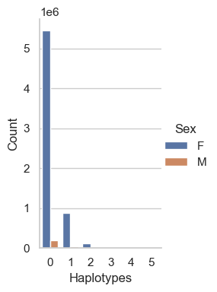
How many defects do individuals carry?
Haplo-types | AY |  | BS |  | HO |  | JE
 | Bulls | Cows | Bulls | Cows | Bulls | Cows | Bulls | Cows
0 | 1,626 | 12,031 | 47,531 | 27,476 | 200,422 | 5,459,679 | 38,649 | 708,497
1 | 1,025 | 5,572 | 6,588 | 4,153 | 33,327 | 877,371 | 9,410 | 141,941
2 | 126 | 657 | 326 | 224 | 4,293 | 120,487 | 542 | 7,881
3 | − | − | 10 | 99 | 187 | 6,427 | − | −
4 | − | − | − | − | 2 | 164 | − | −
5 | − | − | − | − | 0 | 5 | − | −
Council on Dairy Cattle Breeding (April 2025 genetic evaluation run)

Slide 39
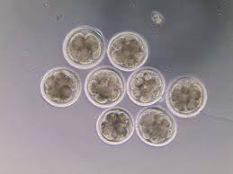
Validation of candidate variants
Cell biology research in large mammals is very expensive
Candidate genes for early embryonic losses not always validated in the laboratory
Targeted knockouts can be used to validate candidates for early embryonic losses
Relatively fast and cost-effective
Source: University of Florida (2013).

Slide 40
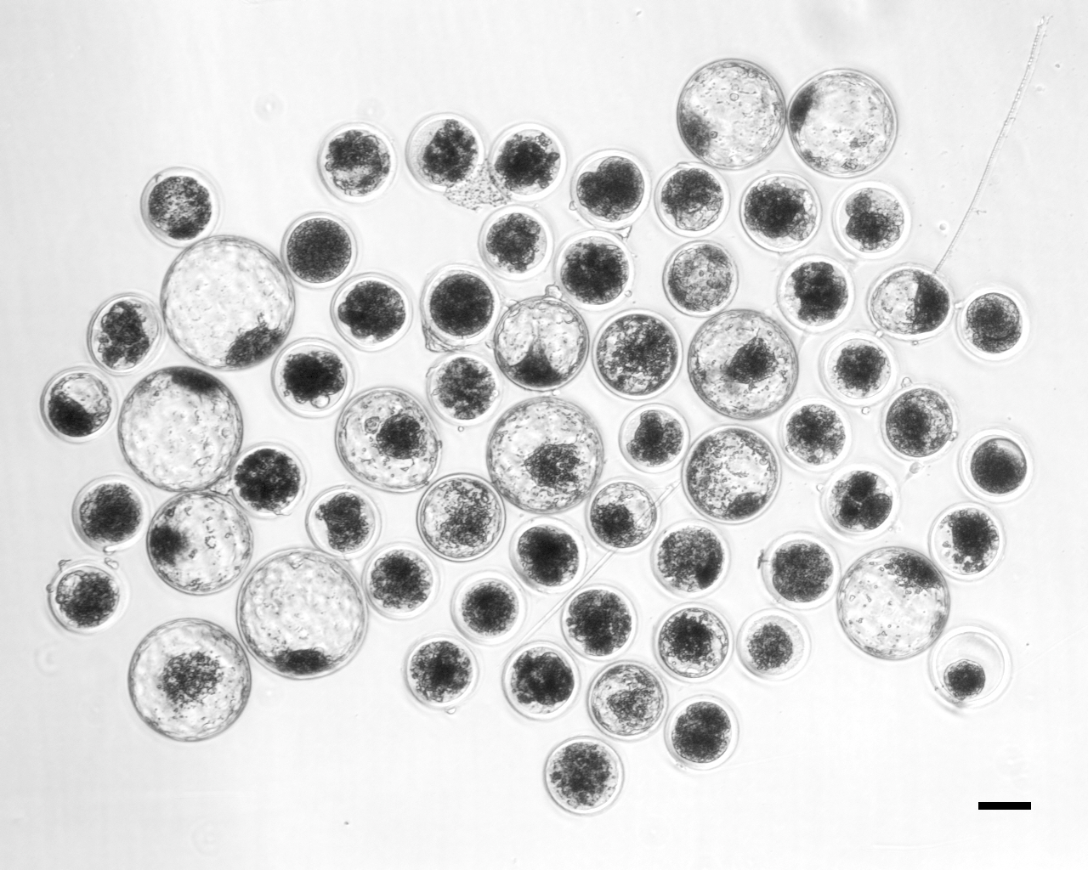
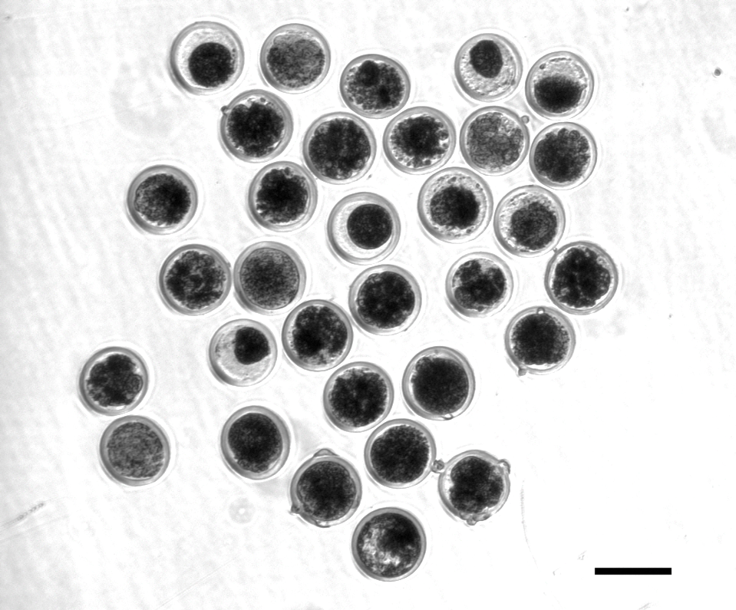
HH2 candidate confirmed with functional validation
Control embryos injected with only Cas-9 (left)
A frameshift in IFT80 at 107,172,615 bp (p.Leu381fs) disrupts wnt and hedgehog signaling, and is responsible for the death of homozygous embryos
A SNP will track the causal mutation
Cole et al. (2022)
Treatment embryos injected with Cas-9 and IFT80 exon 2 guide RNA (right)

Slide 41
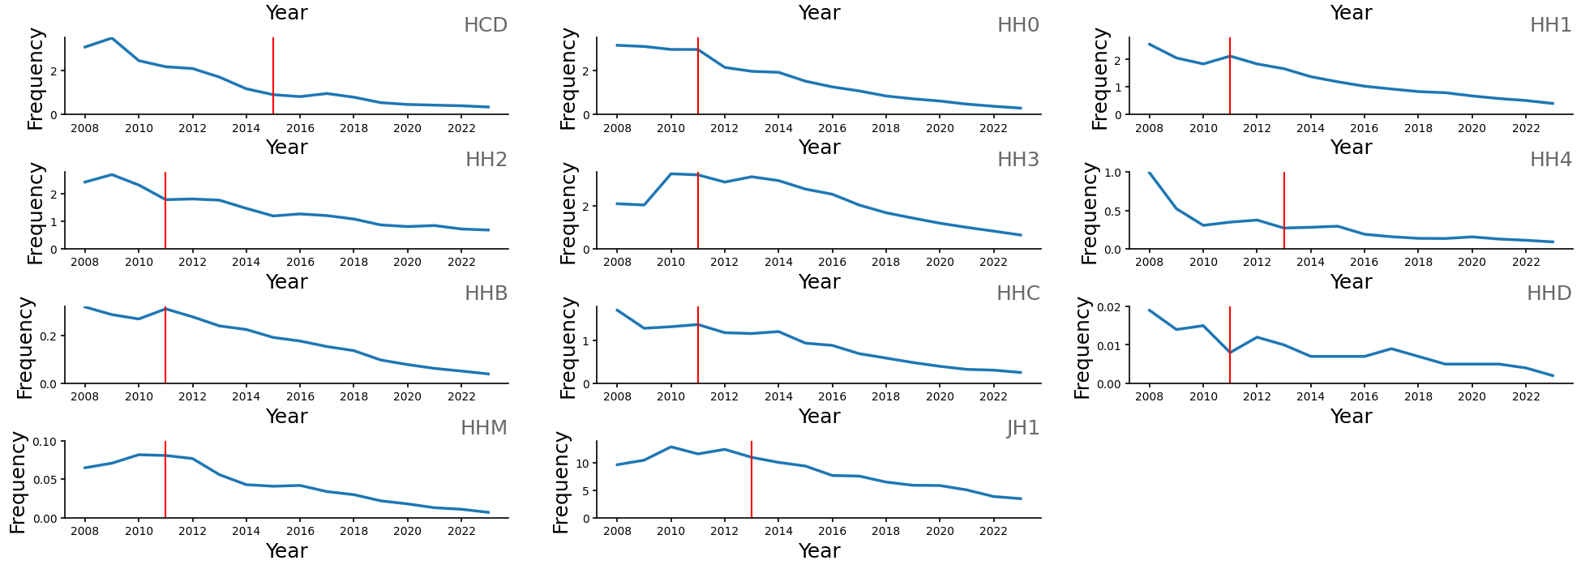
Changes in haplotype frequency
Cole et al. (2025)

Slide 42
Estimated cost of genetic load
Cole et al. (2016; 2025) estimated annual losses of at least ~$4.1 million due to known recessives, a substantial reduction over the last decade from an estimated $10.7 million.
Average losses were $4.34, $0.17, $0.32, and $0.81 in Ayrshire, Brown Swiss, Holstein, and Jersey, respectively.
This is the economic impact of genetic load as it affects fertility and perinatal mortality.
Actual losses are likely to be higher.

Slide 43
Is the number of defects increasing?
MacArthur et al. (2012) estimated that human genomes contain ~100 loss-of-function mutations, and ~20 completely inactivated genes
The mutations are there even if we have not identified them yet
Example: HH6, mutation in SDE2 (Fritz et al., 2018)
Our detection methods are improving as our technology improves
New mutations do occur, but they are very rare

Slide 44
Our ability to detect them has changed
Cole et al. (2025)

Slide 45
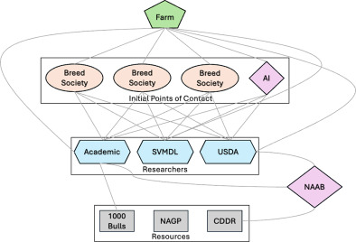
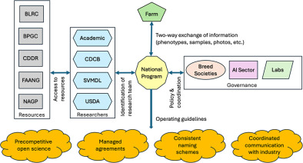
Population management isn’t easy
Current Situation
Proposed Future Structure
Cole et al. (2025, in press)

Slide 46
Conclusion

Slide 47
Are we concerned about the wrong thing?
“Selection, however - in marked contrast to its effectiveness in changing average merit - is a very feeble tool for changing homozygosity, except under the very simplest genetic situations…” (Lush, 1945)
“When the pure breeds finally reach equilibrium between the production of heterozygosis by mutations and the loss of heterozygosis because the effective number of animals in the breed is small, it is possible that the pure breed may support only a few scores of unfixed loci.” (Lush, 1945)

Slide 48
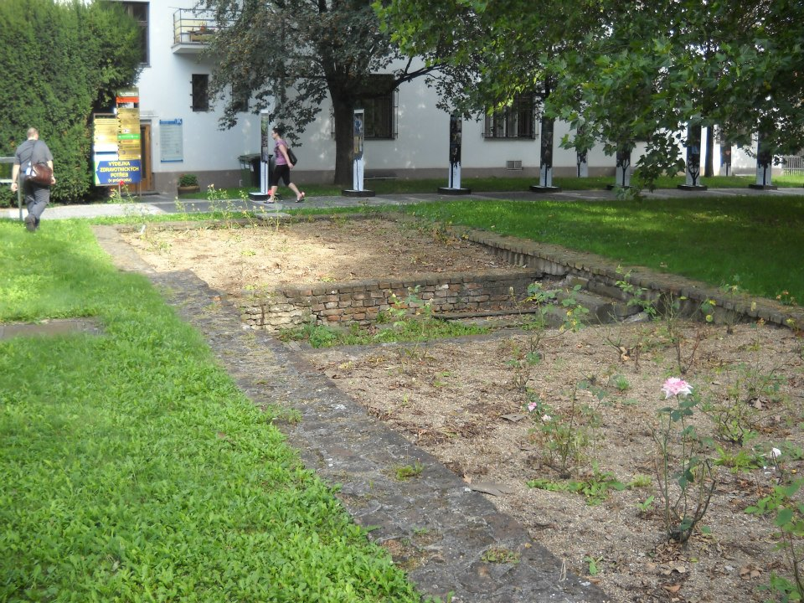
Questions?
Thank you for your attention!
john.cole@uscdcb.com

